Slide 2
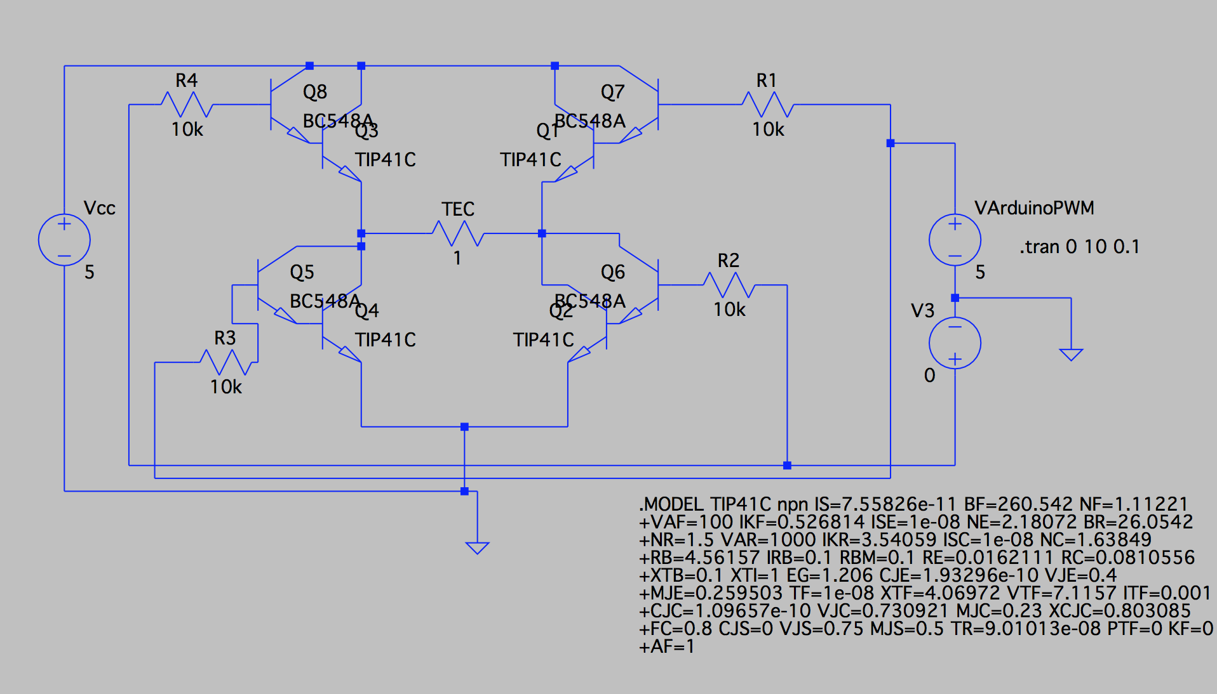

Actuator: H-Bridge
NPN Transistors being used:
TIP41C and BC548B

Slide 3
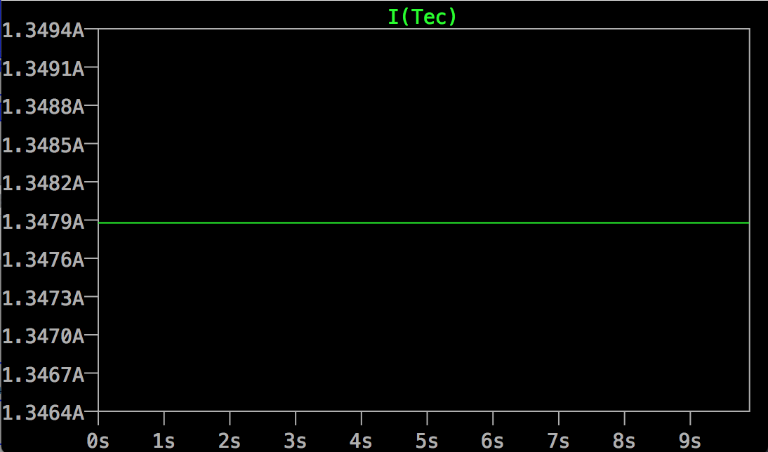
Simulation Result

Slide 4

Details about the circuit
Two Vin: One input for controlling the heating TEC and the other end for controlling cooling TEC
Providing power for the H-bridge:
provided by DC power Supply with 5V and 2A current limit

Slide 5
Details about the circuit
Cooling
Heating
Cooling
Heating

Slide 6
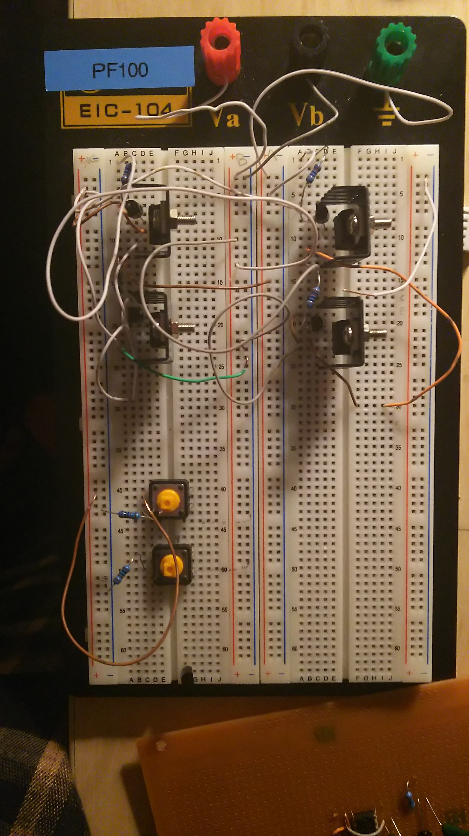
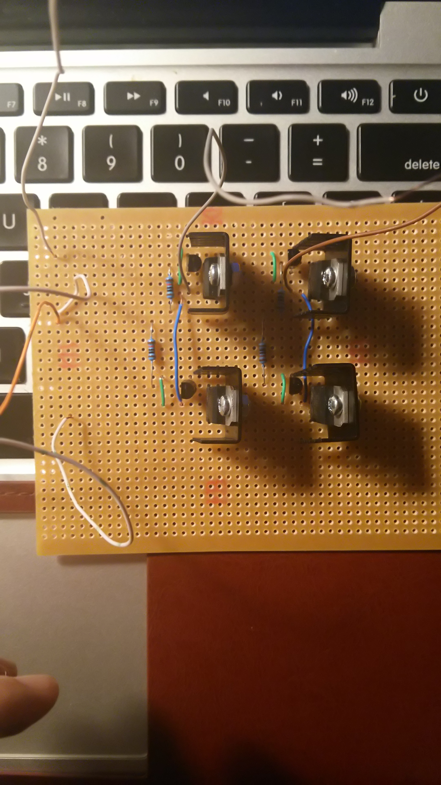
Result from breadborad: 1.3A
Vcc 5V power supply
Heating
Cooling
Common Ground
Result from veroboard: 1A

Slide 7
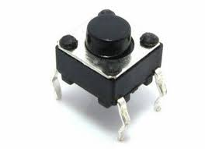
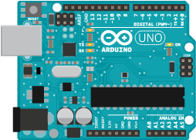
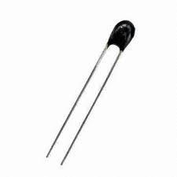
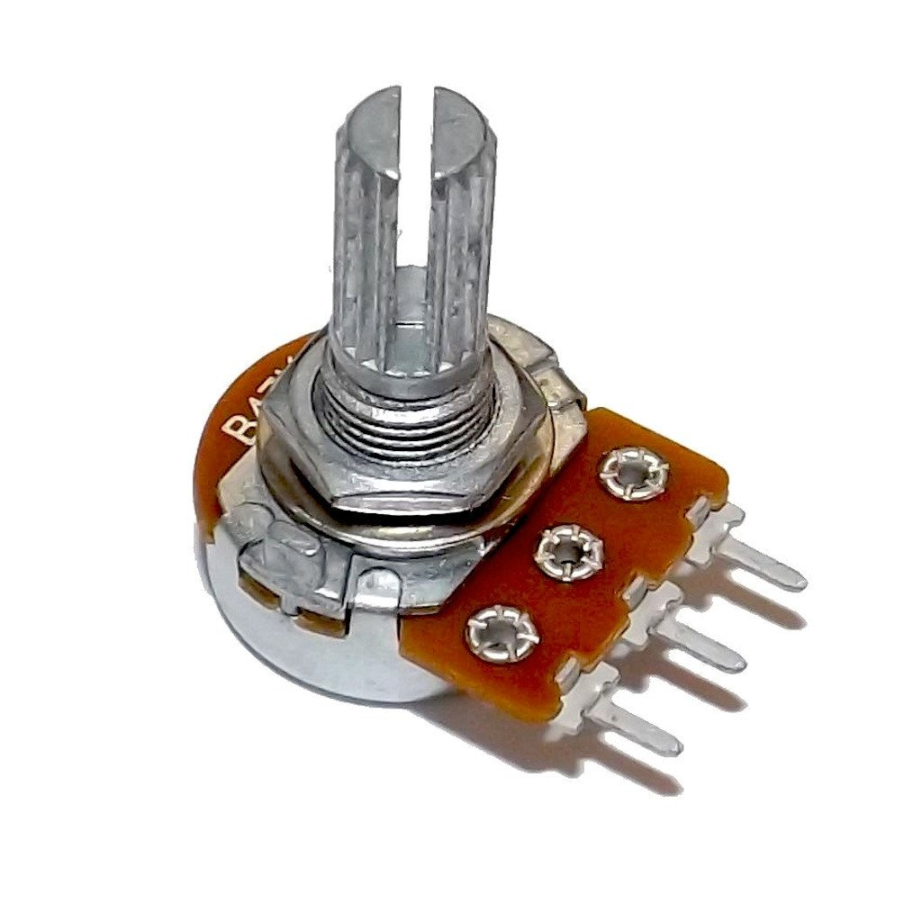
Control Signal
Heat/Cool mode
Cool Mode
OR
Heat Mode
if > 0
HEAT ON
OR
-
COOL ON
Sensor
User Input
else
Absolute difference
Do Nothing
Bang Bang Control

Slide 8
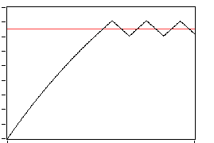
Result
50
45
44.5
40
30
20
around 1 minute

